Slide 1
Phase 2
Project: Java and Web Development
Github repository: https://github.com/PetromirDev/IU-DLBCSPJWD01/
By Petromir Petrov 9213260

Slide 2
Purpose of the Application
A simple web app for users to track books they want to read. Readers can create a profile, manage books across devices, and organize them into categories. The app provides an intuitive way to track reading progress (Want to Read, Reading, Read)

Slide 3
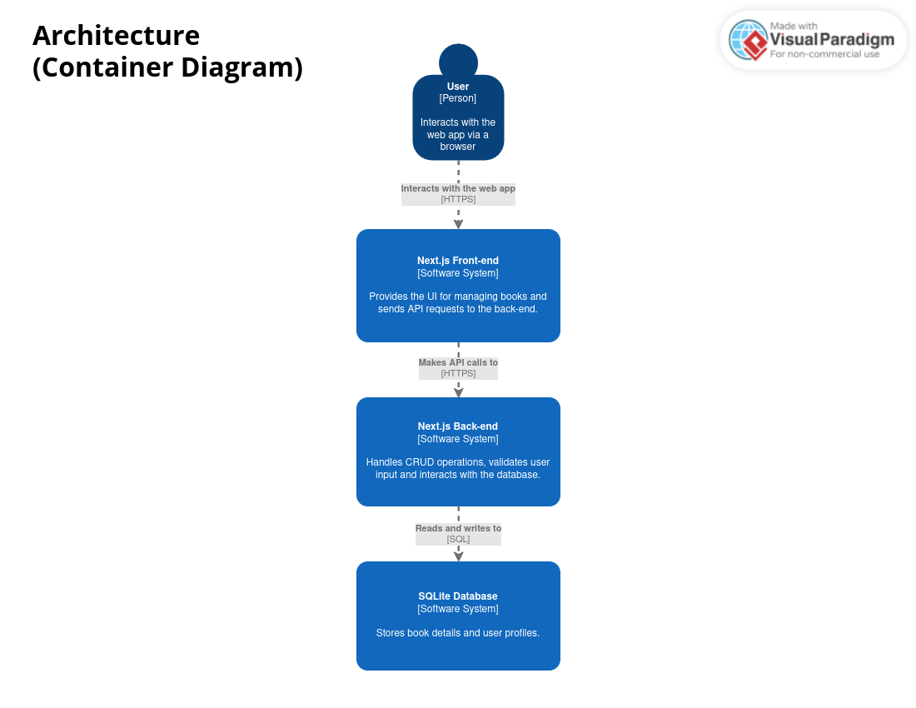

Slide 4
Tech-stack
Front-end
Back-end
Database
Next.js - React framework for SSR & static generation
TypeScript - Statically typed JavaScript
Tailwind CSS - Utility-first styling for responsiveness
ShadCN / Radix UI - UI components
Next.js back-end – Handles requests without API endpoints
TypeScript – Ensures type safety
SQLite – Lightweight and easy to manage

Slide 5
Screenshots

Slide 6
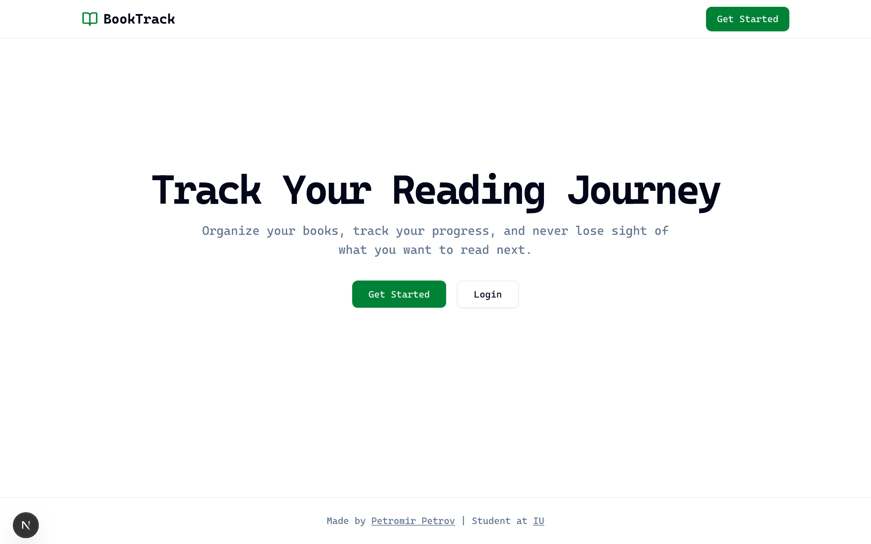
Footer with credits
Call to Actions

Slide 7
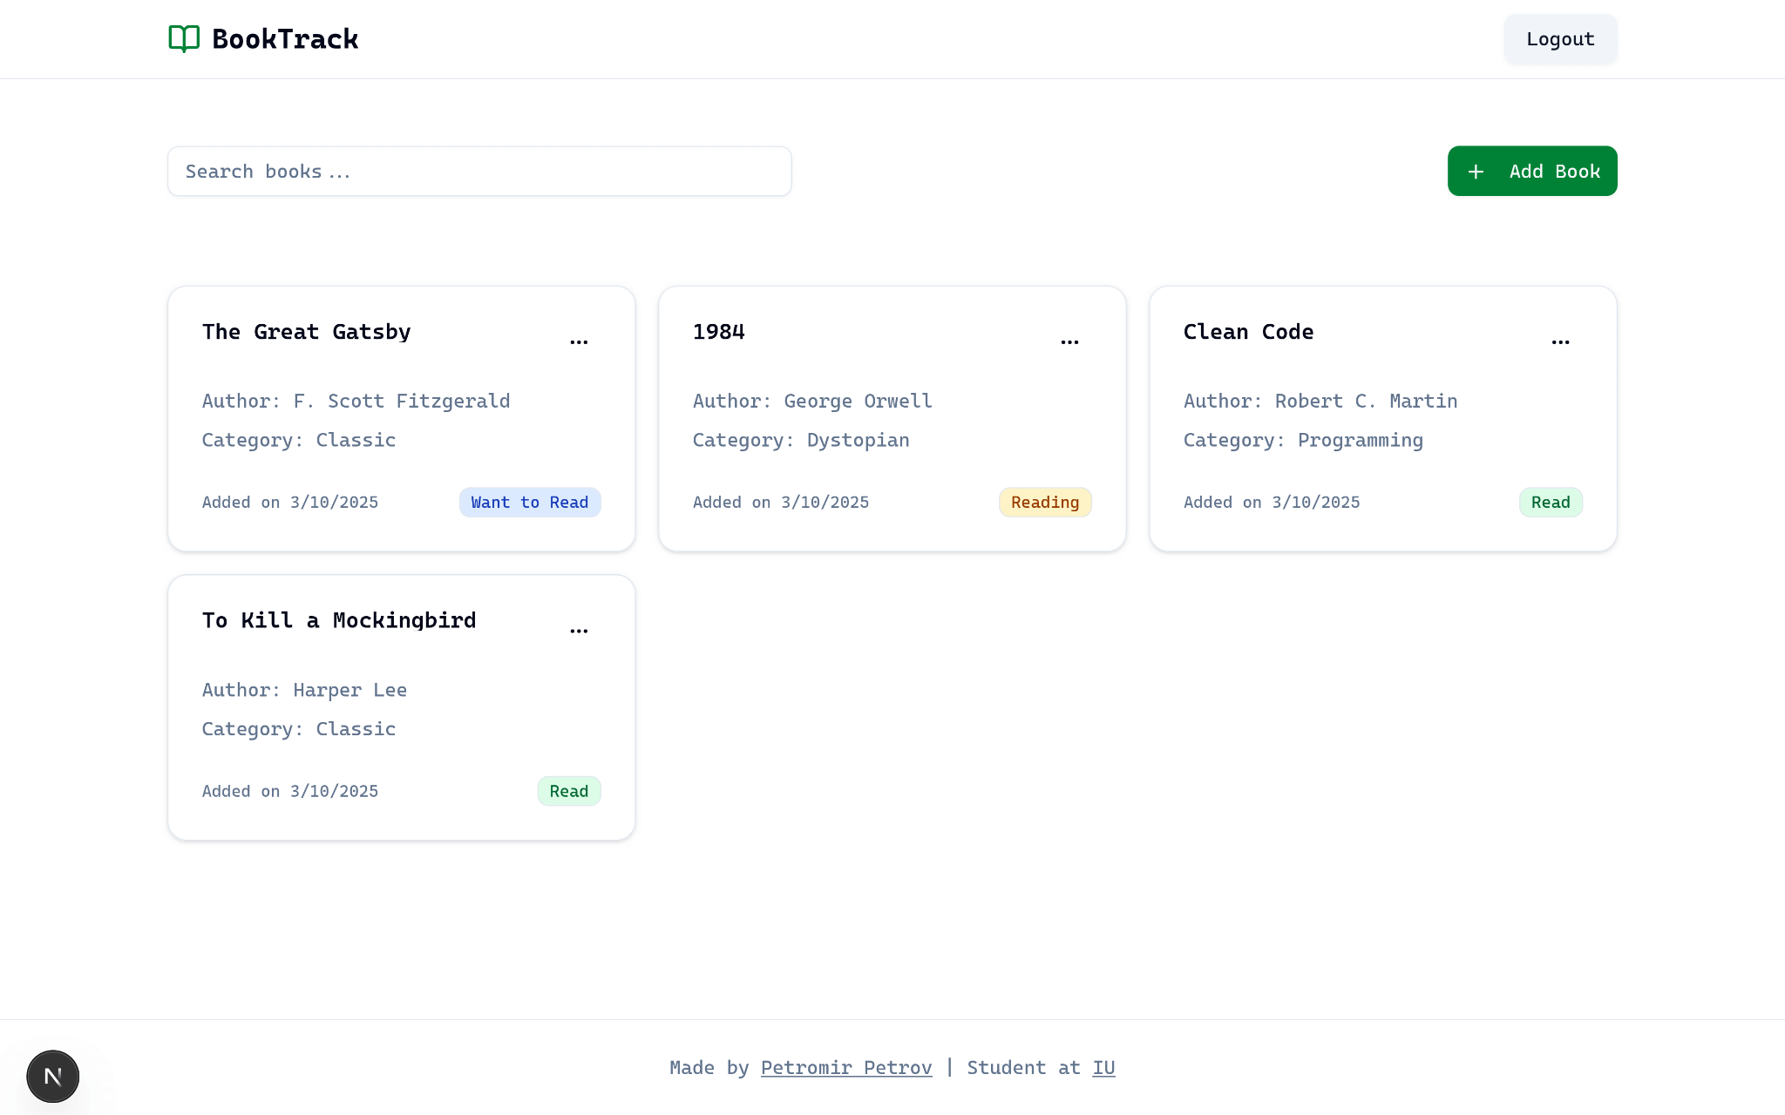
Button to add a new book
Book search
Book entry

Slide 8
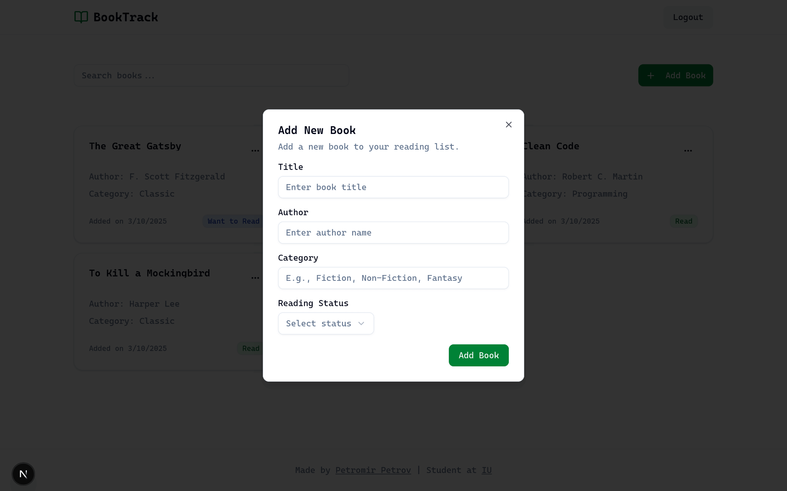
Modal to add new books

Slide 9
Changes to my initial proposal
After reviewing my initial proposal, I decided to keep the original design unchanged. The chosen technologies—Next.js with Server Actions for the back-end, SQLite for the database, and Tailwind with Shadcn for styling—still align well with the project’s goals. I am comfortable with this tech stack since I use it professionally, allowing me to develop the application more efficiently.
Since I haven’t received any feedback suggesting changes, and my initial choices effectively meet the requirements, there was no need for adjustments. However, I remain open to refining the application based on future feedback.

Slide 10
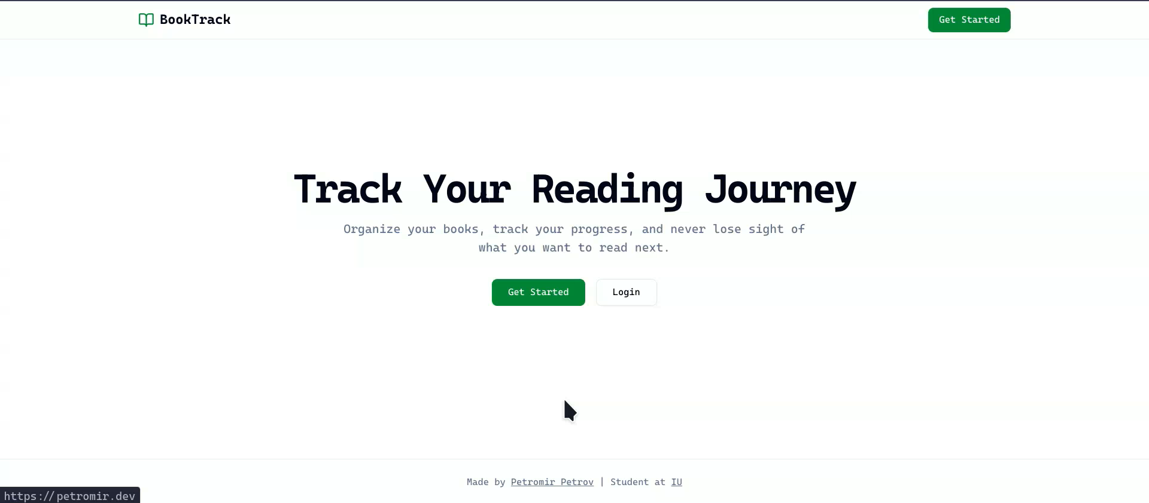

Slide 11


